Slide 1
Semantic Information G Theory for Falsification and Confirmation
Abstract：This theory is a natural Generalization of Shannon’s information theory. It is compatible with Shannon，Popper， Fisher，and Zadeh’s thoughts. The semantic information formula can be used to explain falsification; the confirmation measure is compatible with Confidence Level and Popper’s falsification theory.
Chenguang Lu
Email: Survival99@gmail.com, Homepage: http://survivor99.com

Slide 2
This Theory is a Generalization of Shannon’s information Theory
Several semantic information theories:
Carnap and Bar-Hillel’s
Floridi’s
Yixin Zhong’s
Mine:
A Chinese Book published in 1993:
An English paper published in 1999:
Lu C., A generalization of Shannon's information theory[J].Int. J. of General Systems, 1999，28 (6): 453-490.

Slide 3
Popper’s Thought and Carnap-Bar-Hillel’s Sematic Information Formula
Popper said: The smaller the logical probability of a hypothesis is, the more information there is if the hypothesis can survives experimental tests.
Carnap and Bar-Hillel’s semantic information formula:
I(p)=log(1/mp)
p: a hypothesis; mp: its logical probability.
Advantage: It can ensure that the smaller the logical probability is, the more the information there is.
Disadvantages:
1) No experimental test;
2) Not compatible with Shannon’s information theory.

Slide 4
The Bayes’ Theorem can be distinguished into Three types
Bayes’ Theorem I between two logical probabilities proposed by Bayes:
T(B|A)=T(A|B)T(B)/T(A)
Bayes’ Theorem II between two statistical probabilities, used by Shannon :
Baye’s Theorem III between a statistical probability and a logical probability to link the likelihood function and the truth function：
Membership function or truth function：
Semantic likelihood function
Logical probability

Slide 5
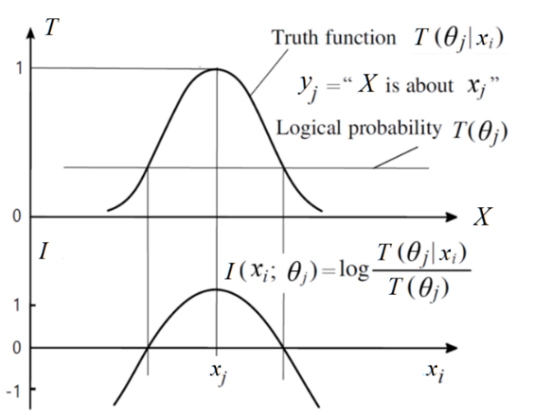
The Sematic Information Measure
The classical information formula
Semantic Information of yj about xi is defined with
log-normalized-likelihood
The less the logical probability is,
the more the information there is.
The larger the true value is, which means
that the hypothesis can survive the test,
the more information there is.
A tautology or contradiction conveys no
information.
Reflects Popper’s falsification thought.
If T(θj |x)≡1 then it becomes Carnap and Bar-Hillel’s formula I=log(1/mp).
$$I(x_{i};y_{j})=log\frac{\left.P(x_{i}|y_{j}\right)}{\left.P(x_{i}\right)}$$

Slide 6
Optimizing Truth Functions with Maximum Semantic Information Criterion
Averaging I(xi;θj), we obtain Generalized Kullback-Leibler information:
Optimized truth function when sampling distributions are discontinuous: sampling distribution

Slide 7
Semantic Mutual Information Formula
Averaging I(X;θj), we have semantic mutual information formula
If T(θj|X)=exp[-k(yj-xi)²], a Gaussian function without coefficient, then
It is easy to find that the semantic mutual information criterion is a special Regularized Least Square (RLS) criterion, and the cross-entropy is the regularizer.

Slide 8
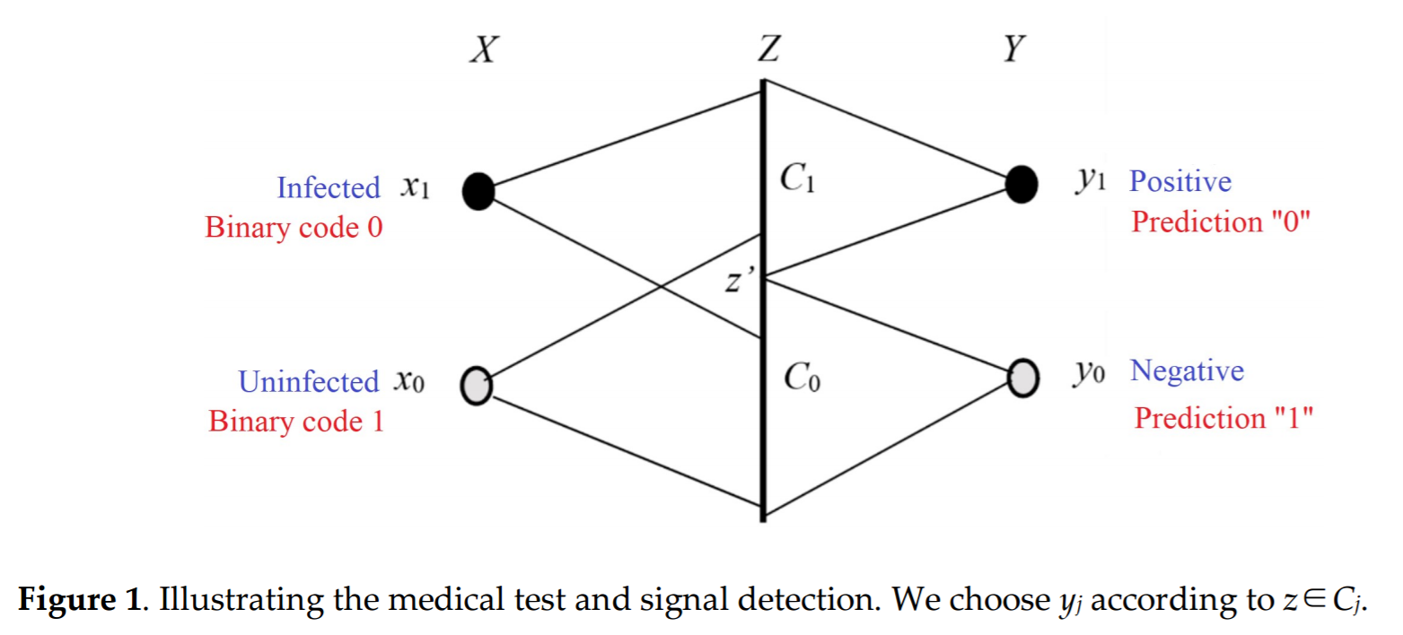
Shannon’s Channel for Medical Tests
We use the medical test to explain the Shannon channel and the Semantic channel, and the new confirmation measure.
positive y1 means a prediction
“The testee is probably infected”;
negative y0 means
“The testee is probably
uninfected”.
We need to know the degrees
of confirmation of y1 and y0
according sensitivity and
specificity.
Z: A laboratory datum

Slide 9
From Shannon’s Channel to the Optimized Semantic Channel
A fuzzy hypothesis’ truth function: T(θ₁|x)= b₁’ +b₁T(A_{j}|x); T(A_{j}|x)∈{0,1}
b1=Degree of belief; b1’=1-|b1|= Degree of disbelief
Semantic channel:
To bring the above truth functions into the Generalized Kullback-Leibler formula,
To optimize b1’ to maximize I(X;θ1), we have the optimized degree of disbelief
Similarly
counterexamples’ rate positive examples’ rate

Slide 10
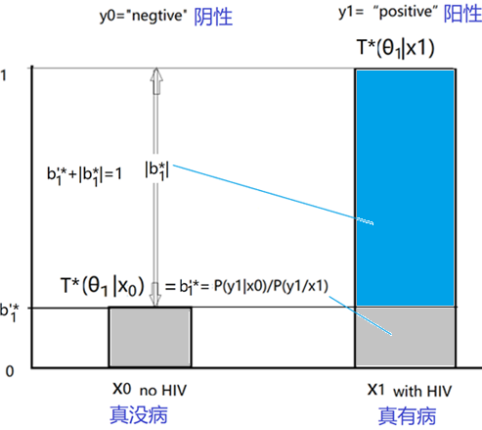
The Degree of Confirmation is Defined as the Optimized Degree of Belief
Degree of Confirmation is defined by |b1*|=1- b’*;
The degree of disconfirmation b1’* is the true value of a counterexample.
The true value of a counterexample

Slide 11
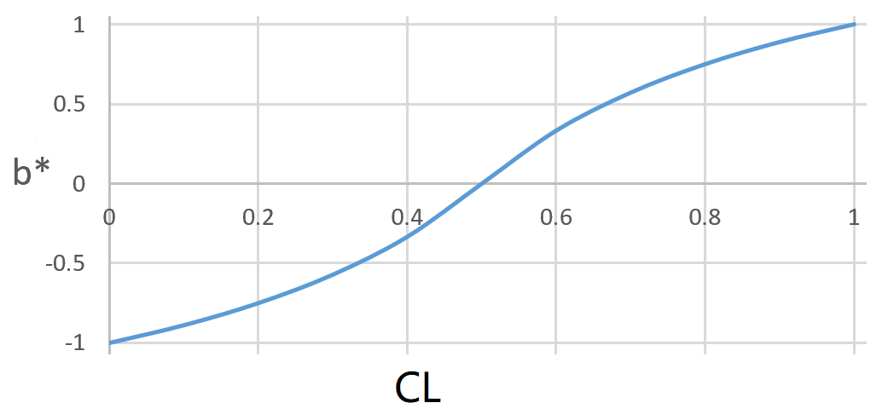
Degree of Confirmation b* vs Confidence Level CL
Consider b1* may be less than 0, we have
CL’=1-CL
Confidence Level of y1=“positive”:
CL₁=P(y₁|x₁) /[P(y₁|x₀)+P(y₁|x₁)]
b1* has HS symmetry proposed by Eells and Fitelson：
It ensures that y1 with (b*= -1) ≡ y1’with (b*=1)
For example, “All ravens are white” with b1*≈-1” ≡ “All ravens are not white with b1*=1”.
Important conclusions:
1) The degree of confirmation b1* of “positive” mainly depends on the correct rate of “negative”, vise versa.
2) Less incorrect examples are more important than more correct examples. So, b* is compatible with Popper’s falsification theory.

Slide 12
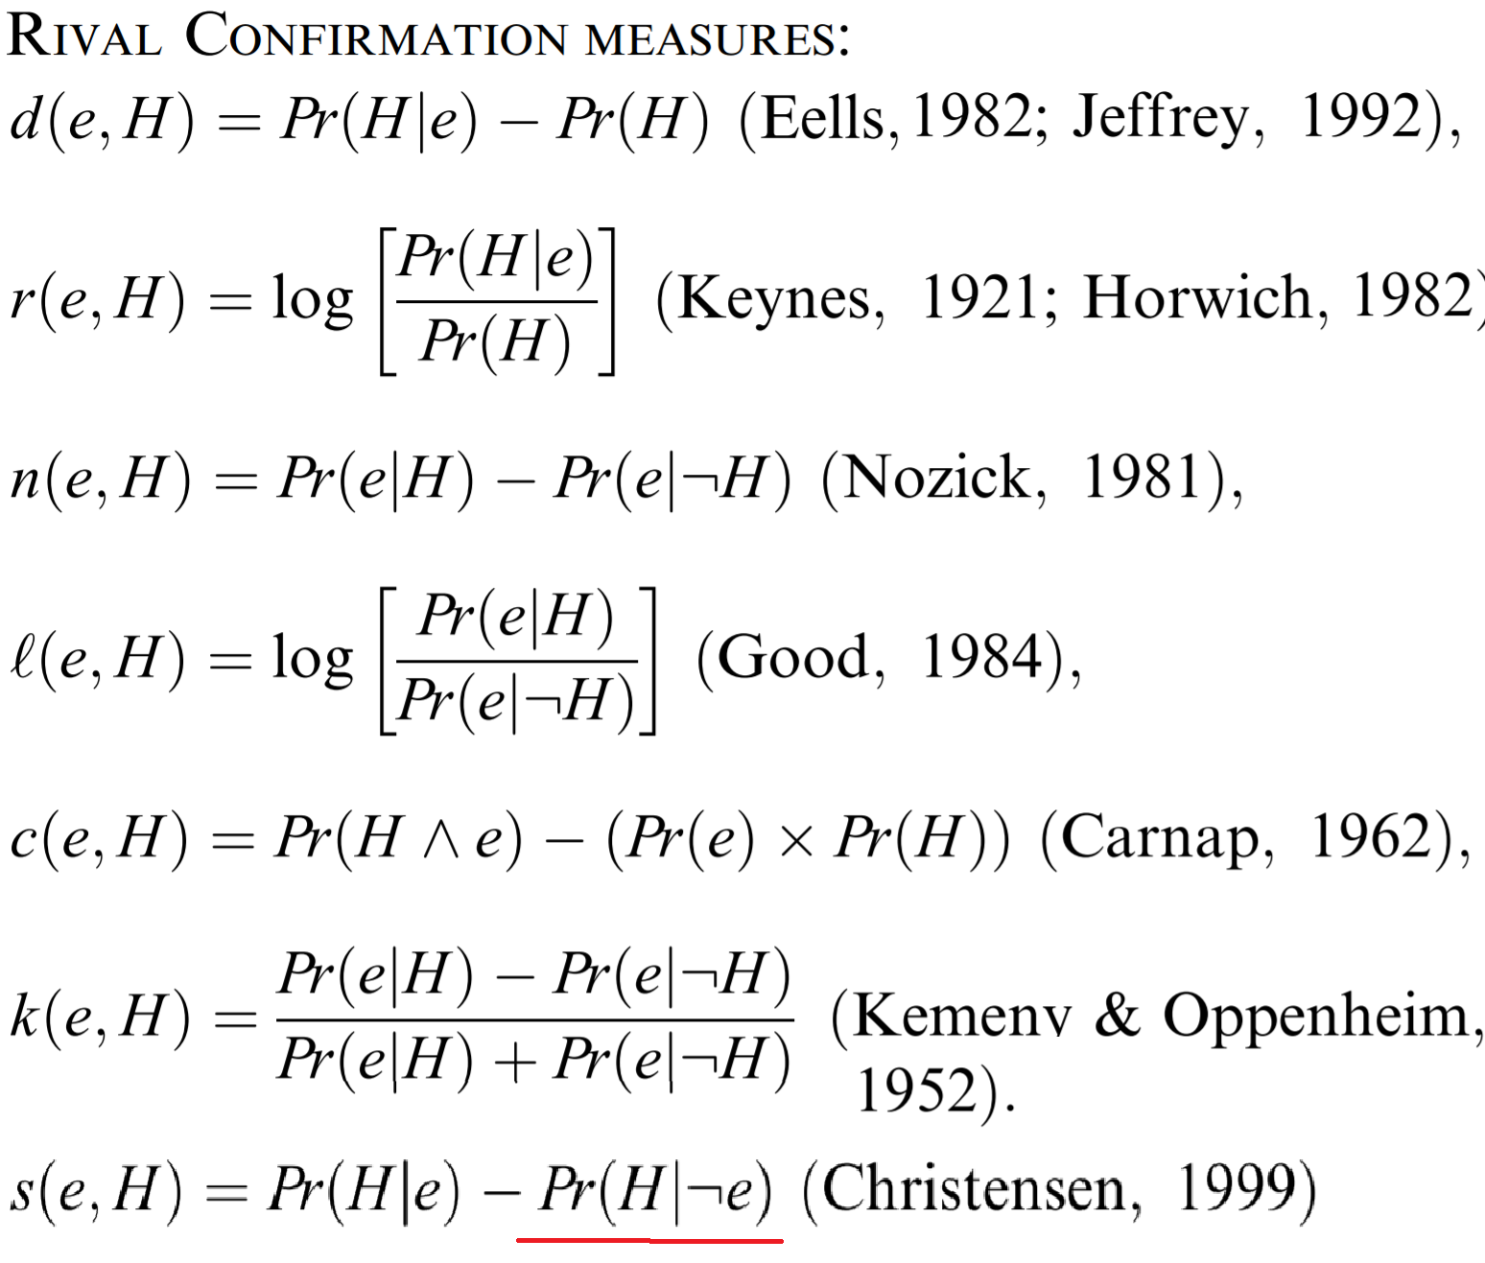
Comparing b* with Popular Confirmation Measures
Tentori, K. et al.:
Comparison of conﬁrmation
measures. Cognition 103(1),
107–119 (2017).
H=y1; e=x1; דH=y0; דe=x0
Pr(H|e)=P(y1|x1): sensitivity
Pr(דH|דe)=P(y0|x0): specificity

Slide 13
A Crucial Example to Examine All Measures
Two Medical tests: A and B
A: Sensitivity=1, Specificity=0.1; b1*=0.1; b0*=1; y0 is more believable.
B: Sensitivity=0.1,Specificity=1. b1*=1; b0*=0.1; y1 is more believable.
Whose y1=“Positive” is more believable?
According most existing measures, A’s y1 has high confirmation measure or is more believable than B’s y1. According to s(e,H), A’s y1 and B’s y1 are the same; s(e,H)=0.1
According to my b1*, B’s y1 (b1*=1) is much more believable than A’s y1 (b1*=0.1).
If you ask doctors who know confidence level, they will tell you mine is correct because B’s y1 has no counterexample, and its confidence level CL is 1.

Slide 14
Summary
Semantic information measure:
Information=log(True_value/Logical_probability)
Confirmation measure b* is compatible with Popper’s falsification theory:
End
Thanks for your listening!
Welcome to exchange ideas.
For more papers about semantic information theory and machine learning, see
http://survivor99.com/lcg/cm/recent.html
or http://arxiv.org/a/lu_c_3

